Slide 1
Hoogvliet is kut lmao

Slide 2
Inhouds opgave
Daar doen we niet aan

Slide 3
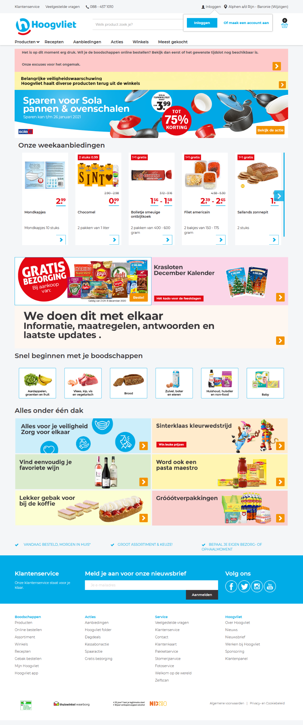
Notes:
Het wosrdt gedraait interwebshop

Slide 4
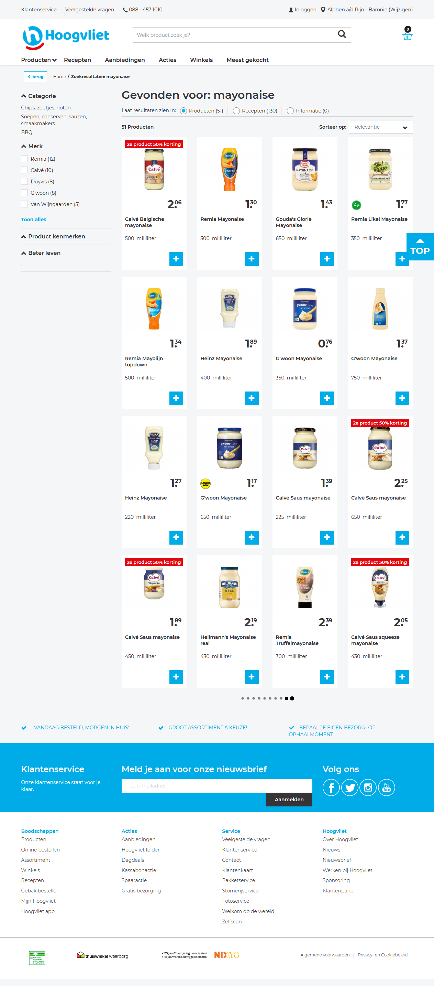
Notes:
Er wordt een keydown of keyup evenement die een jqueary verzoek stuurt

Slide 5
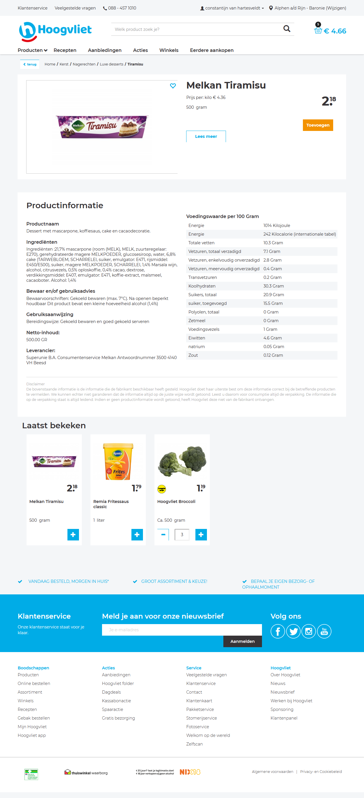
<button name="addProduct" class="btn btn-action showQtyToggle addToCartBtn" title="Toevoegen" data-testing-id="addToCartButton" data-track-click="{
&quot;clickType&quot;: &quot;productAddToCart&quot;,
&quot;products&quot;: [{
&quot;id&quot; : &quot;054852000&quot;,
&quot;name&quot; : &quot;Tray 24 x 250 ml blikken&quot;,
&quot;category&quot; :&quot;Frisdrank, sappen, koffie, thee/Frisdrank/Sport-, energiedrank&quot;,
&quot;price&quot; : &quot;10.80&quot;,
&quot;brand&quot; : &quot;Slammers&quot;,
&quot;quantity&quot; : &quot;1&quot;,
&quot;isVegetarion&quot; : &quot;0&quot;,
&quot;isNew&quot; : &quot;0&quot;,
&quot;isLowestPrice&quot; : &quot;1&quot;,
&quot;freshDays&quot; : &quot;0&quot;,
&quot;isFairTrade&quot; : &quot;0&quot;,
&quot;isBiological&quot; : &quot;0&quot;,
&quot;isBetterLife&quot; : &quot;0&quot;,
&quot;isGluten&quot; : &quot;0&quot;,
&quot;isNatrium&quot; : &quot;0&quot;
}]
}" data-track-contentview="{
&quot;viewType&quot;: &quot;productDetailView&quot;,
&quot;products&quot;: [{
&quot;id&quot; : &quot;054852000&quot;,
&quot;name&quot; : &quot;Tray 24 x 250 ml blikken&quot;,
&quot;category&quot; :&quot;Frisdrank, sappen, koffie, thee/Frisdrank/Sport-, energiedrank&quot;,
&quot;price&quot; : &quot;10.80&quot;,
&quot;brand&quot; : &quot;Slammers&quot;,
&quot;quantity&quot; : &quot;0&quot;,
&quot;isVegetarion&quot; : &quot;0&quot;,
&quot;isNew&quot; : &quot;0&quot;,
&quot;isLowestPrice&quot; : &quot;1&quot;,
&quot;freshDays&quot; : &quot;0&quot;,
&quot;isFairTrade&quot; : &quot;0&quot;,
&quot;isBiological&quot; : &quot;0&quot;,
&quot;isBetterLife&quot; : &quot;0&quot;,
&quot;isGluten&quot; : &quot;0&quot;,
&quot;isNatrium&quot; : &quot;0&quot;
}]
}" data-track-multiple="True">Toevoegen</button>

Slide 6
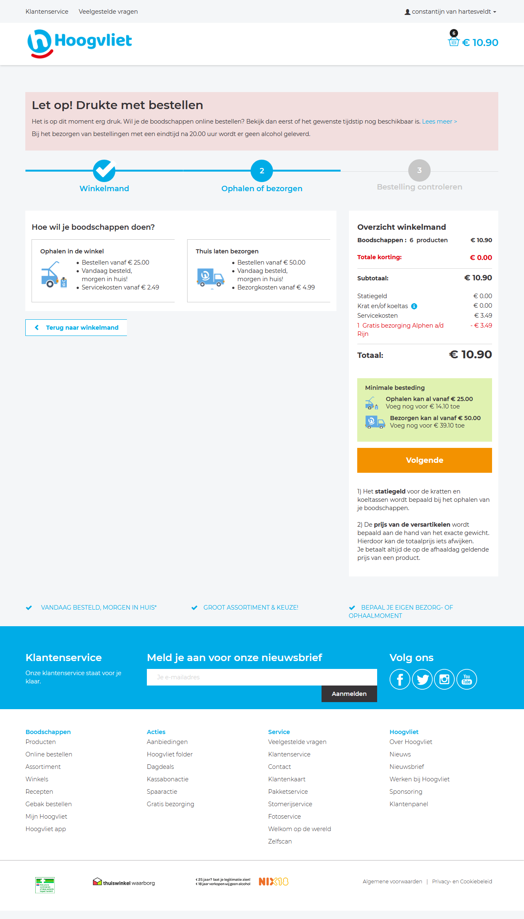
function(a) {
if ($("#UnresolvedTermsInCart").length > 0) {
a.preventDefault();
$("#changeStoreModal").hide();
$("#modal-cart-progress-bar-proceed").hide();
$("#modal-cart-checkout-proceed").modal("show");
}
}

Slide 7
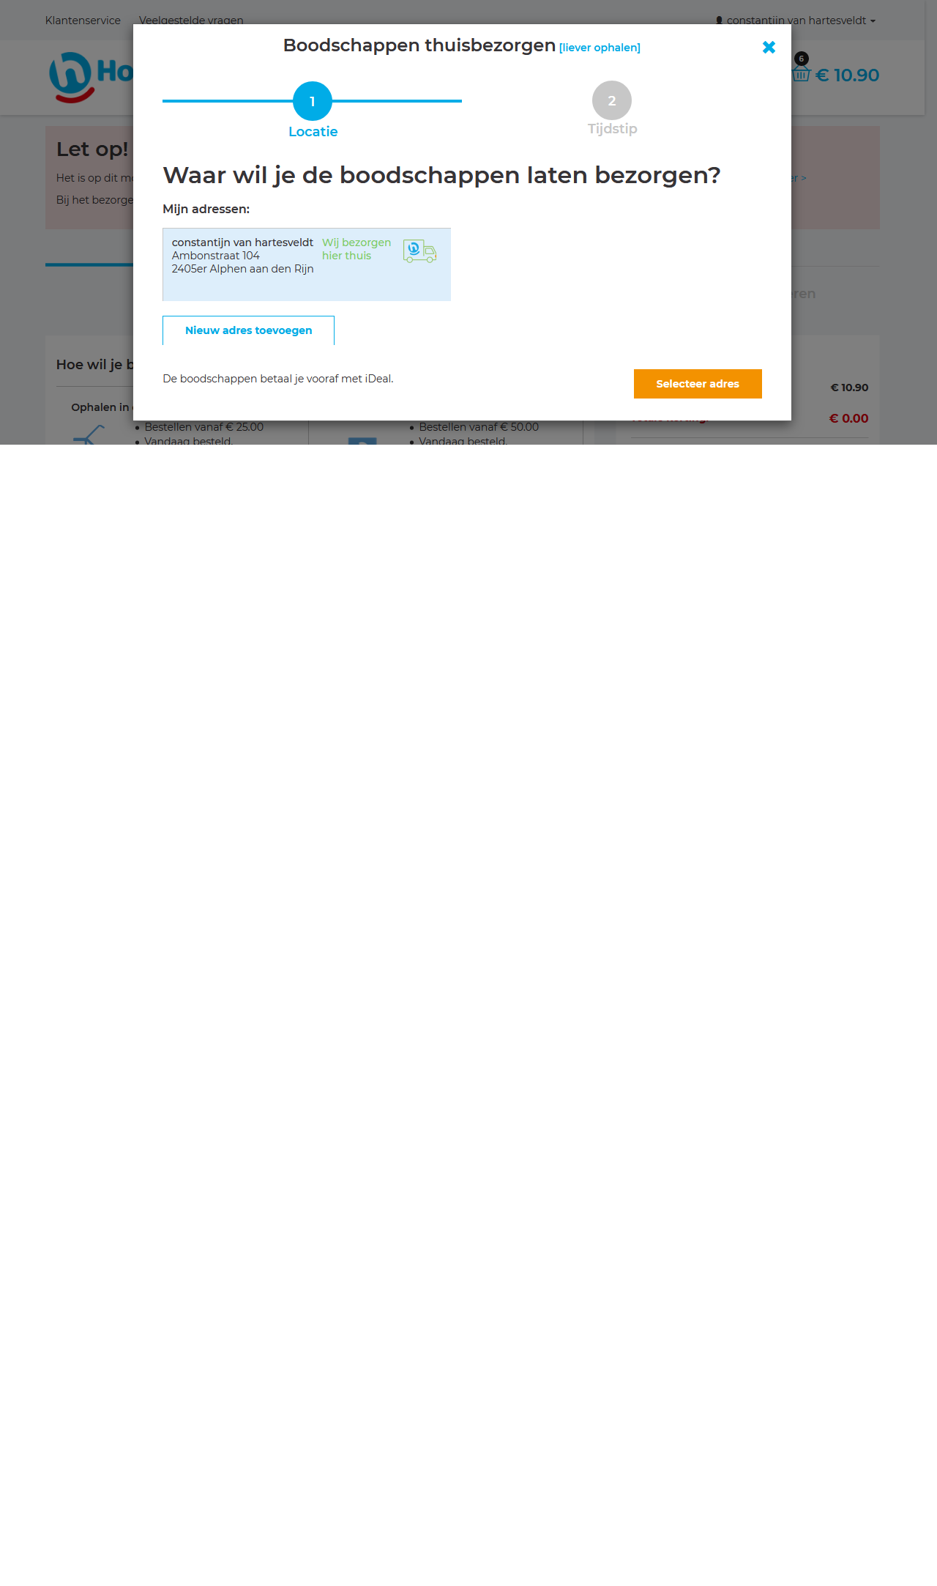
Notes:
Een laaste pop up die vraagt waar je het wilt hebben

Slide 8
Hosts:
Website:
https://www.shodan.io/host/45.60.196.165
Mail servers:
https://www.shodan.io/host/83.80.24.52
https://www.shodan.io/host/185.138.209.152

